Slide 1

Samenvatting R week 1 en 2
a) kans bepalen (default: lower.tail=T)
pnorm(q=5100000,mean=5000000,sd=40000)
[1] 0.9937903
b) percentielen bepalen
c) steekproef trekken en er een histogram van laten maken
rand1<-rnorm(n=100, mean=50,sd=2)
hist(rand1)

Slide 2
Betrouwbaarheidsintervallen
les 3
hoofdstuk 6

Slide 3
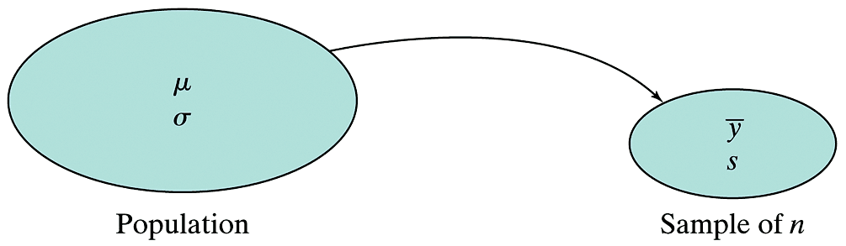
Confidence intervals

Slide 4
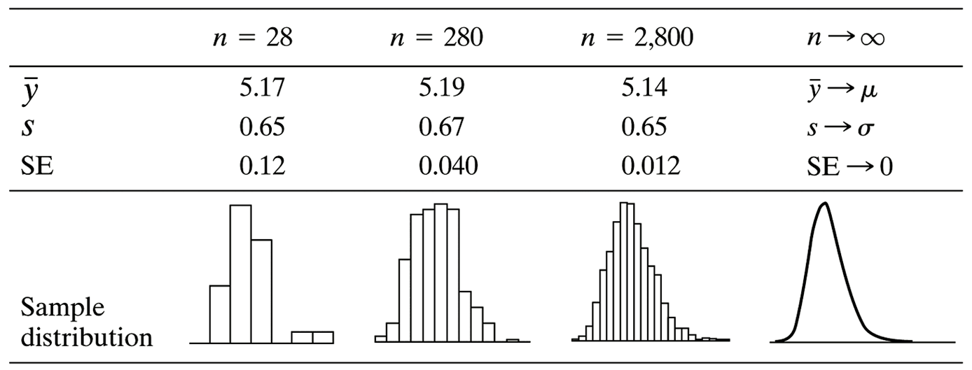
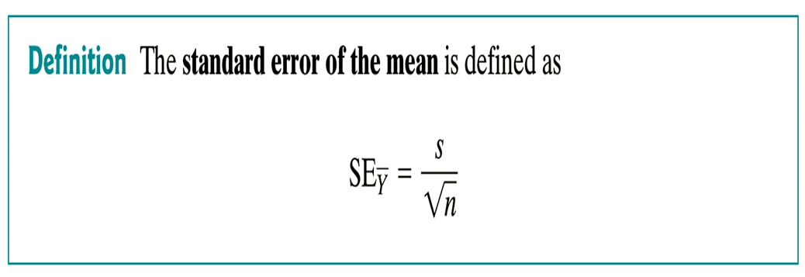

Slide 5
rand1<-rnorm(n=20,mean=50,sd=3)
mean(rand1)
[1] 50.09302
rand2<-rnorm(n=20,mean=50,sd=3)
mean(rand2)
[1] 50.03762
rand3<-rnorm(n=20,mean=50,sd=3)
mean(rand3)
[1] 50.76805
rand4<-rnorm(n=20,mean=50,sd=3)
mean(rand4)
[1] 49.97564
rand5<-rnorm(n=20,mean=50,sd=3)
mean(rand5)
[1] 50.61046

Slide 6
sd(rand1)
[1] 2.980425
sd(rand2)
[1] 2.735111
sd(rand3)
[1] 2.898732
sd(rand4)
[1] 2.33817
sd(rand5)
[1] 3.859035

Slide 7
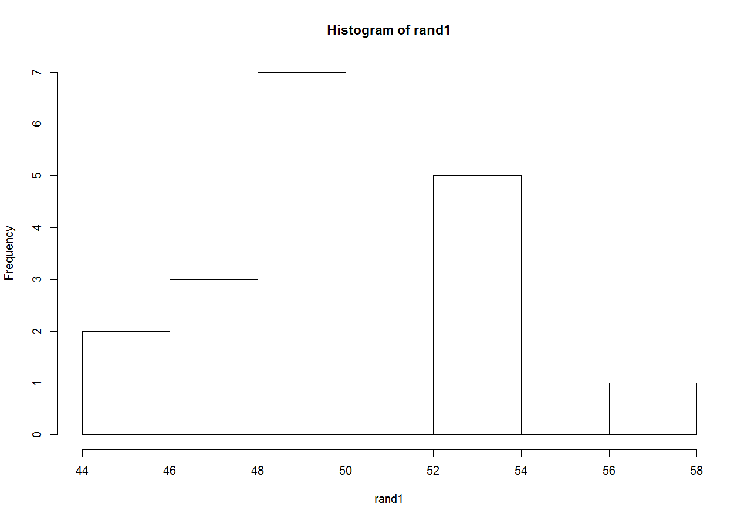
SD=2.980425

Slide 8
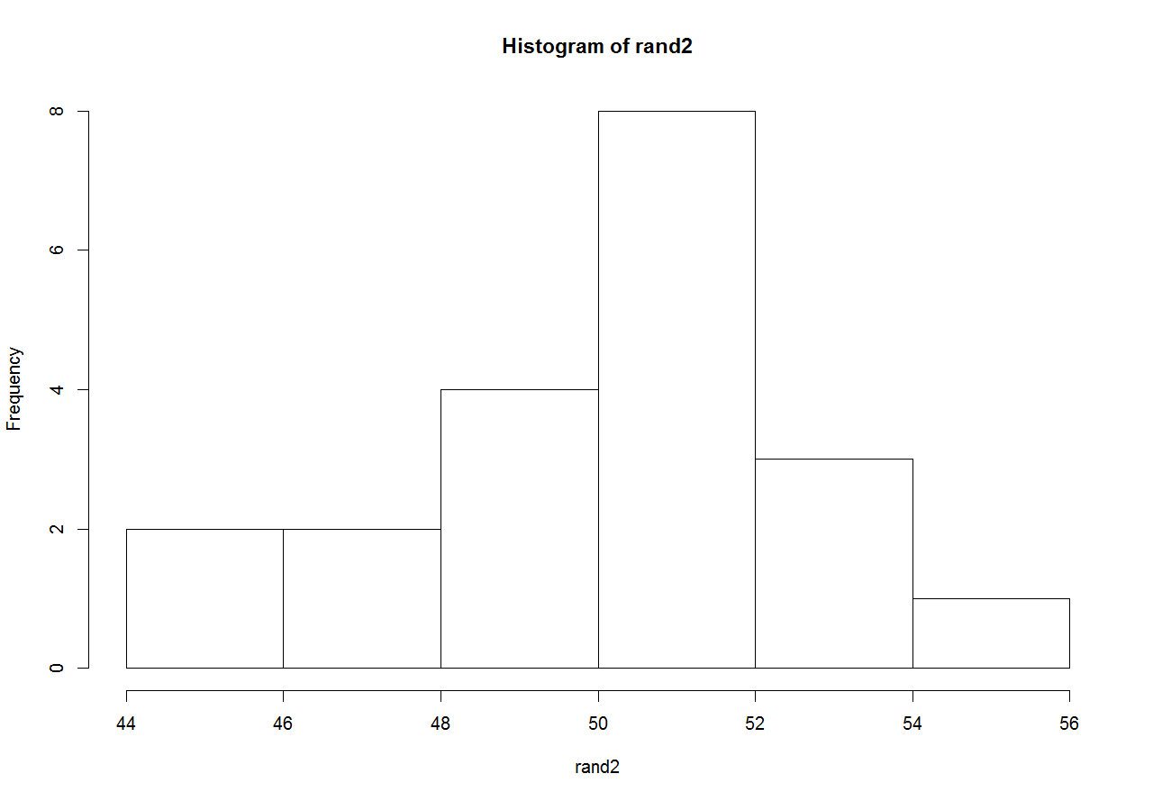
SD=2.735111

Slide 9
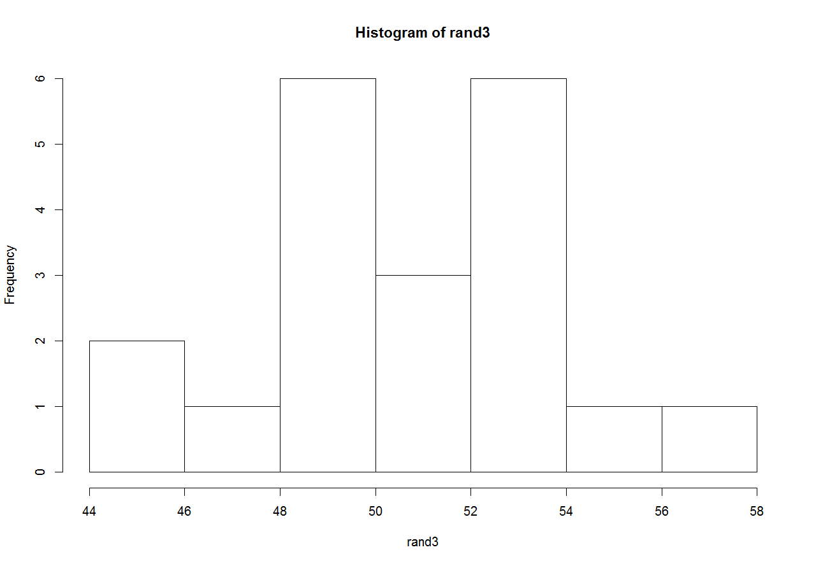
SD=2.898732

Slide 10
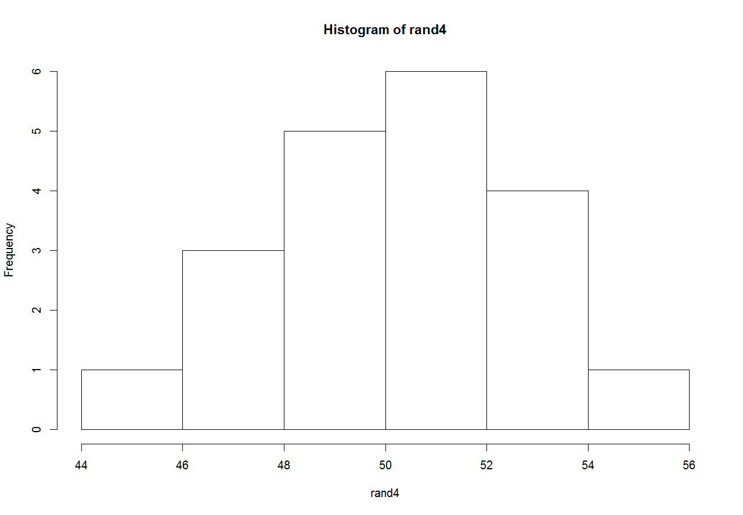
SD=2.33817

Slide 11
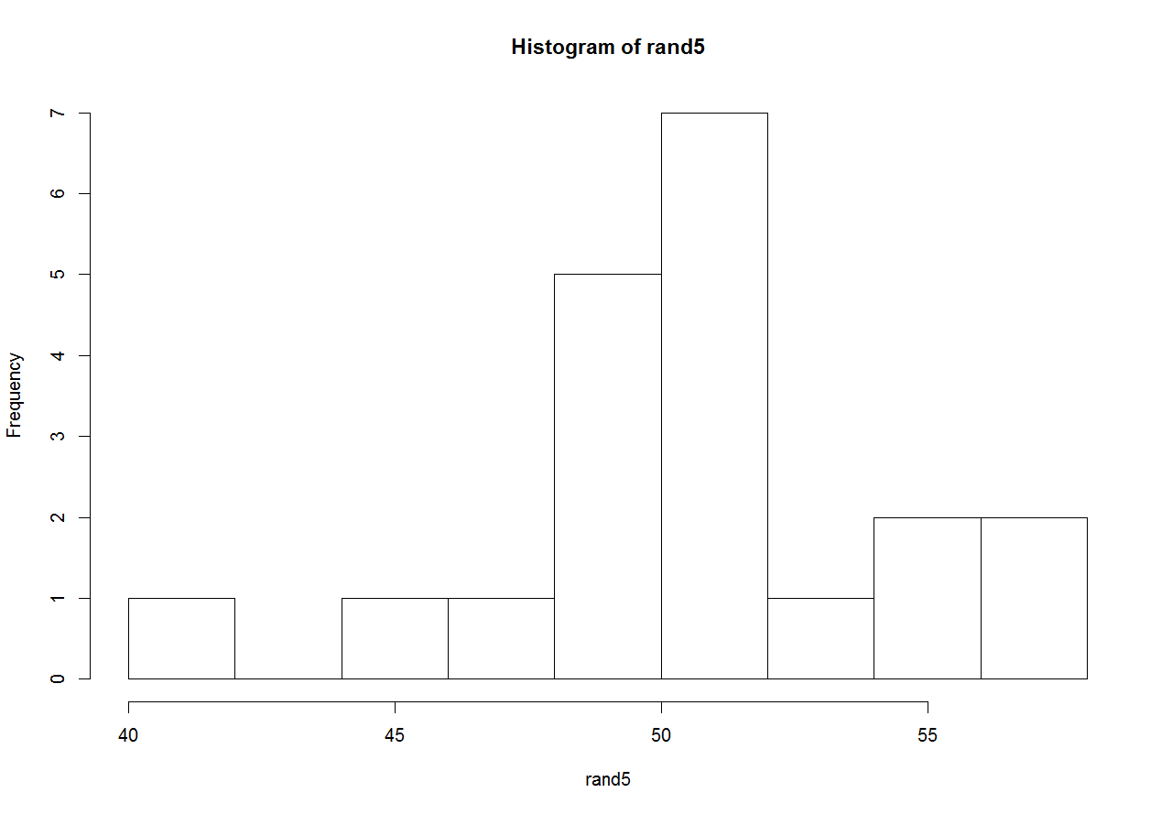
SD=3.859035

Slide 12
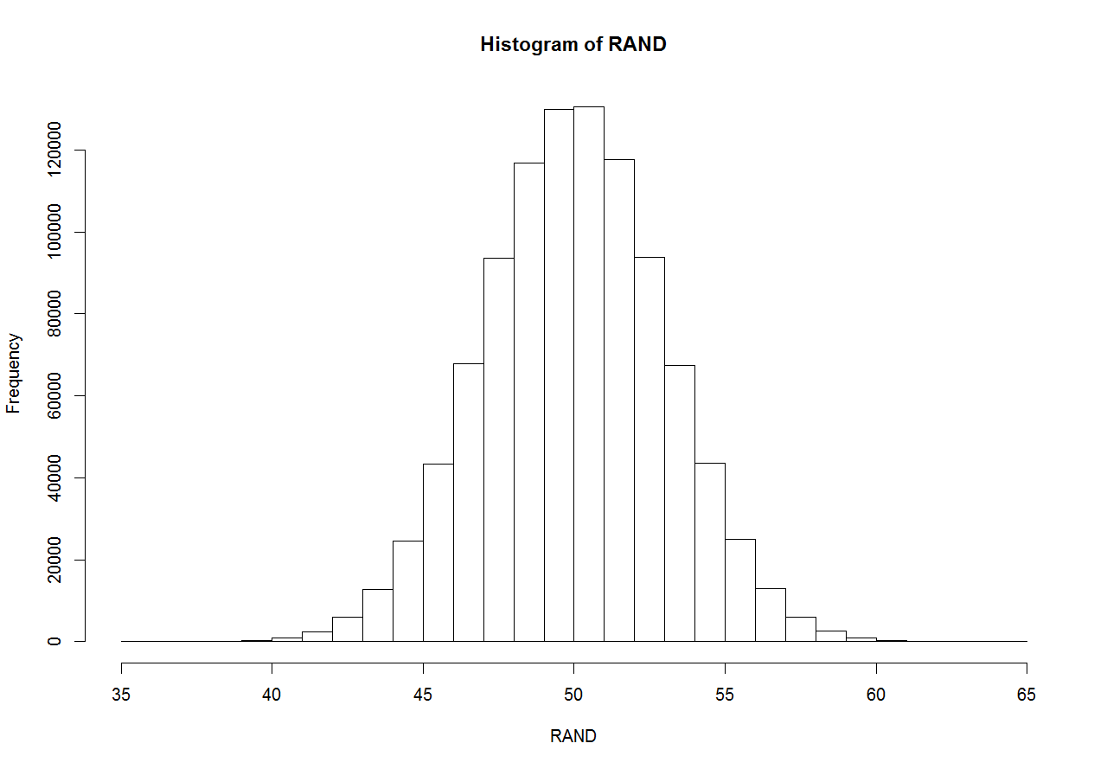
RAND<-rnorm(n=1000000,mean=50,sd=3)
mean(RAND)
[1] 50.00684
sd(RAND)
[1] 2.999221
hist(RAND)

Slide 13

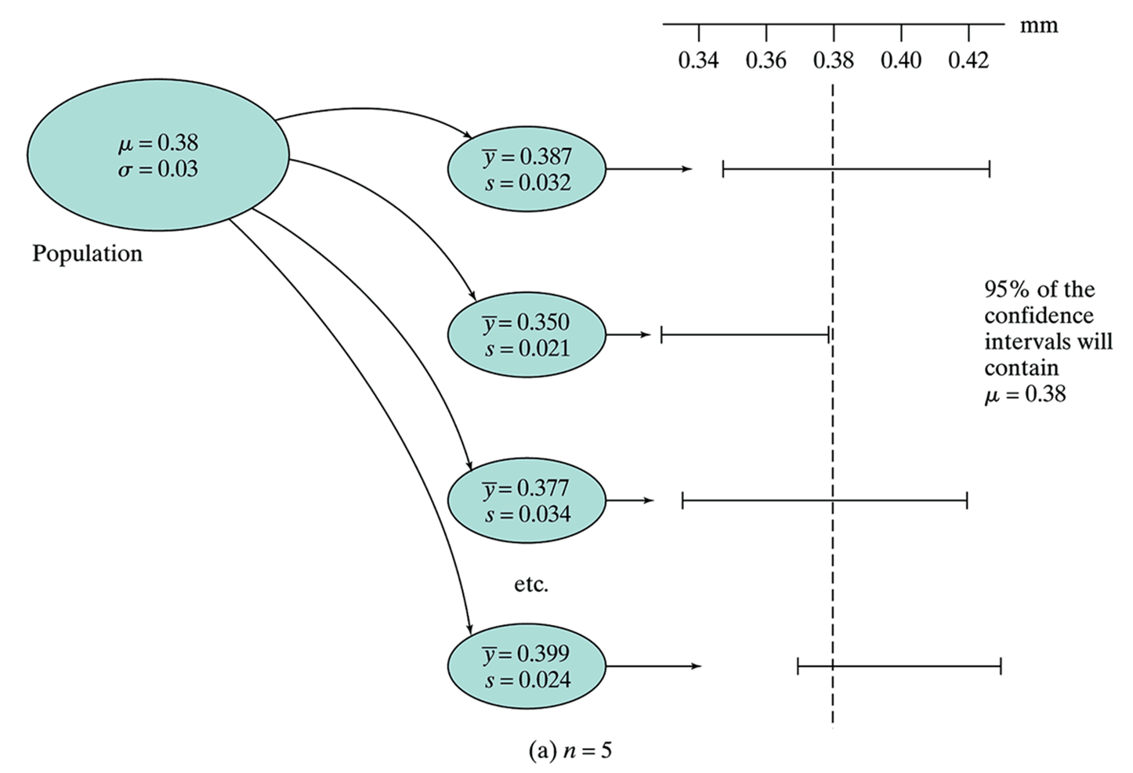

Slide 14

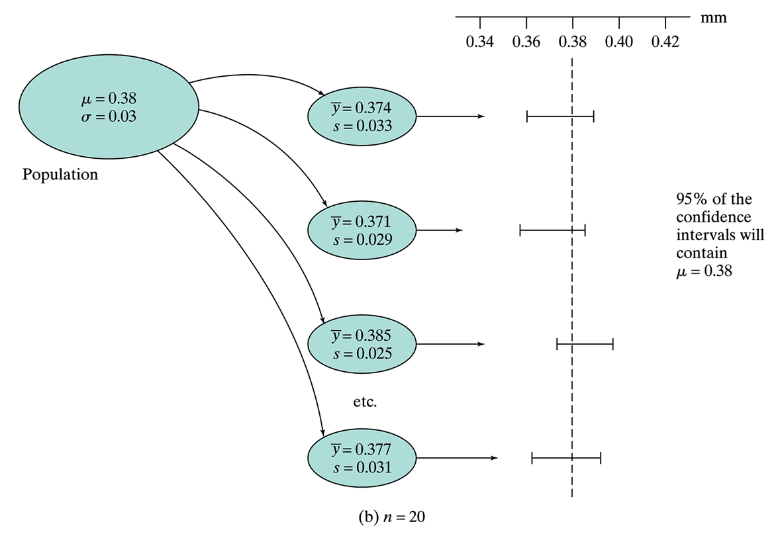

Slide 15
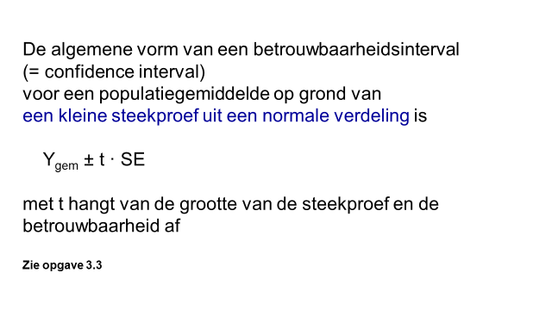

Slide 16
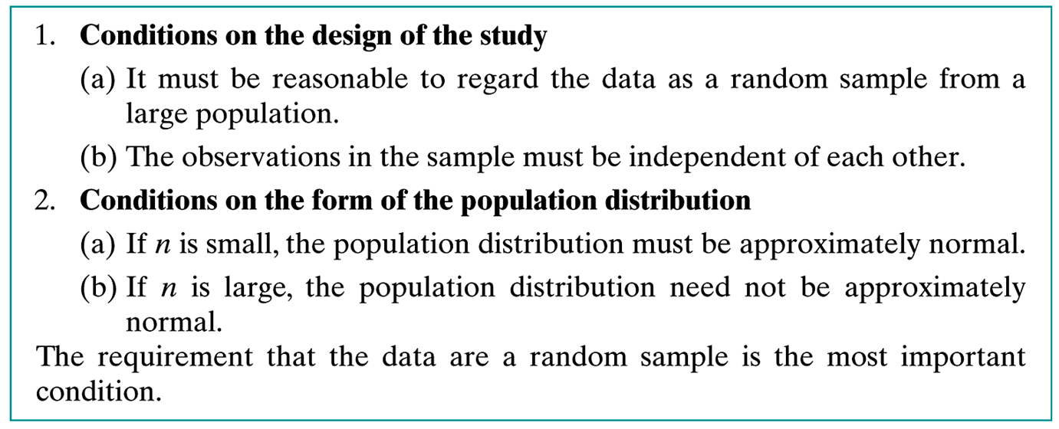

Slide 17
Hoe maak je nu zo’n interval m.b.v. R?
response<-c(6.2, 6.6, 7.1, 7.4, 7.6, 7.9, 8, 8.3, 8.4, 8.5, 8.6, 8.8, 8.8, 9.1, 9.2, 9.4, 9.4, 9.7, 9.9, 10.2, 10.4, 10.8, 11.3, 11.9)
n = length(response)
s = sd(response) # sample standard deviation
se = s/sqrt(n) # standard error estimate
qt(.975, df=n-1) # t=waarde bij 95% betrouwbaarheid
[1] 2.068658
E = qt(.975, df=n−1)∗se #margin of error
# We combine it with the sample mean, and find the confidence interval.
xbar =mean(response)
xbar+c(-E,E) # a 95% confidence interval
[1] 8.292017 9.499649 # 8.3 to 9.5

Slide 18
Instead of using the textbook formula, we can apply the t.test function in the built-in statspackage, when the data are normally distributed with unknown variance. We illustrate the use of this command for the response data.
response= c(6.2, 6.6, 7.1, 7.4, 7.6, 7.9, 8, 8.3, 8.4, 8.5, 8.6, 8.8, 8.8, 9.1, 9.2, 9.4, 9.4, 9.7, 9.9, 10.2, 10.4, 10.8, 11.3, 11.9)
If we use the t.test command listing only the data name, we get a 95% confidence interval for the mean after the significance test.
t.test(response)
One Sample t-test
data: response
t = 30.4769, df = 23, p-value < 2.2e-16
alternative hypothesis: true mean is not equal to 0
95 percent confidence interval:
8.292017 9.499649 #Note here that R reports the interval using more decimal places than was used in the data!
sample estimates:
mean of x 8.895833

Slide 19
#The t.test command can also be used to find confidence intervals with levels of confidence different from 95%.
We do so by specifying the desired level of confidence using the conf.level option.
t.test(response, conf.level = 0.9)
90 percent confidence interval: 8.395575 9.396092
#Make a plot showing the 100 confidence intervals as horizontal lines, with a vertical line at the population mean of 9.
plot(range(conf.int), c(0, 1 + n.draw), type = "n", xlab = "mean tail length", ylab = "sample run")
for (i in 1:n.draw) lines(conf.int[, i], rep(i, 2), lwd = 2)
abline(v = 9, lwd = 2, lty = 2)
#Dit werkt zo niet omdat conf.int niet is gedefinieerd.

